Slide 1

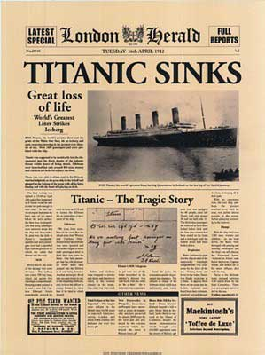
TITANIC: MACHINE LEARNING FROM DISASTER

Slide 2
PROBLEM DEFINITION
Predicting if a passenger survived the tragedy.
Survived variable used for prediction will be 0 and 1.

Slide 3
DATA SET
Classified As:
Training Data: (891 tuples)
Will be used to build and train the machine learning model. Training set will have the ground truth for each passenger (0 or 1).
Test Data: (418 tuples)
Will be used to test or see how accurate the model will work if there is an unseen data.

Slide 4
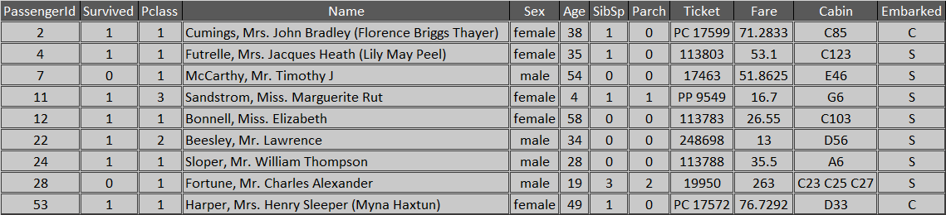
DATA DICTIONARY
Sample Dataset
Passenger ID
Passenger Class
Passenger Name
Sex
Age
Number of passenger's siblings and spouses on board
Number of passenger's parents and children on board
Ticket Number
Fare
Cabin
City where passenger embarked
Survival

Slide 5
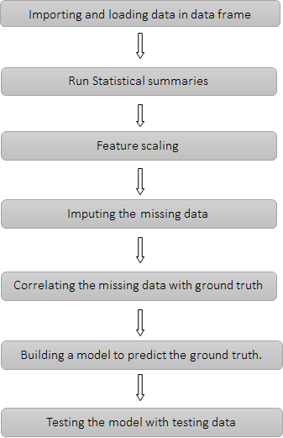
PROJECT PLAN

Slide 6
DATA MINING ALGORITHMS
Missing Values: Fare: Uses median of all Fare Values Embarked: Uses the most frequently used embarkment. Ages: Median of different Age based on Gender and passenger class
LOGISTIC REGRESSION: Validating assumption and Decisions. Performed by calculating the coefficients of the features.
NAIVE BAYES: For analysing the data used for Classification and regression analysis
DECISION TREE: Mapping the variables with ground truth (survived - 1 or not survived - 0)

Slide 7
Visualization

Slide 8
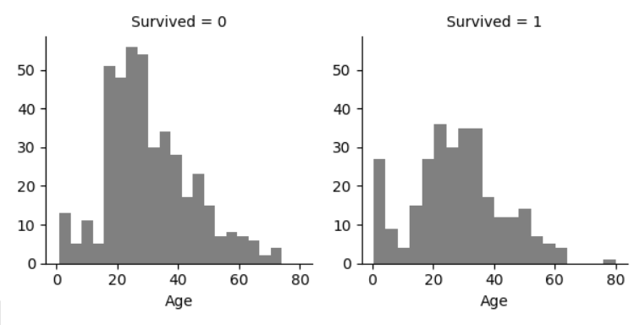
Observation based on AGE
Most of the passengers are of age 15 – 40
Children of age less than 5 and passengers of age 60 to 80 has higher survival rate.
Age to be considered for the model training.

Slide 9
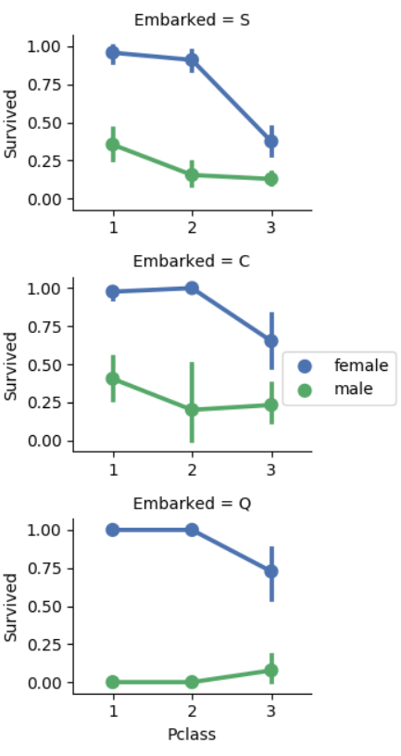
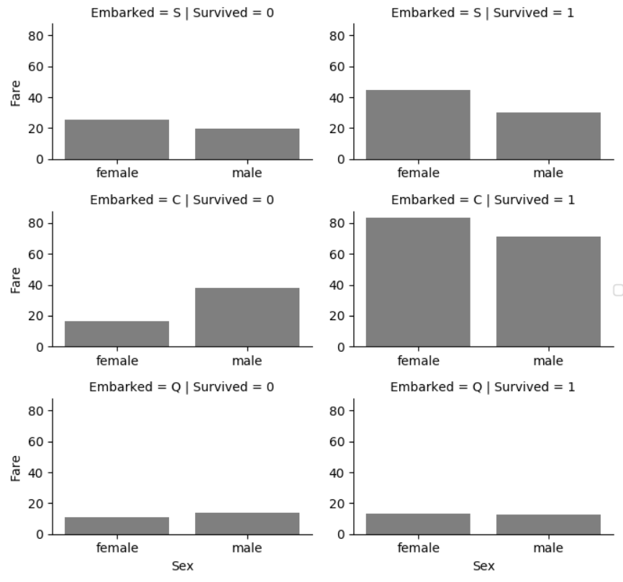
Observation based on EMBARKED
Survival rate was higher for the females port of embarkation, however survival rate is high for the passengers who paid higher fair.
Since port of embarkation correlates with survivability, embarkment to be considered.

Slide 10
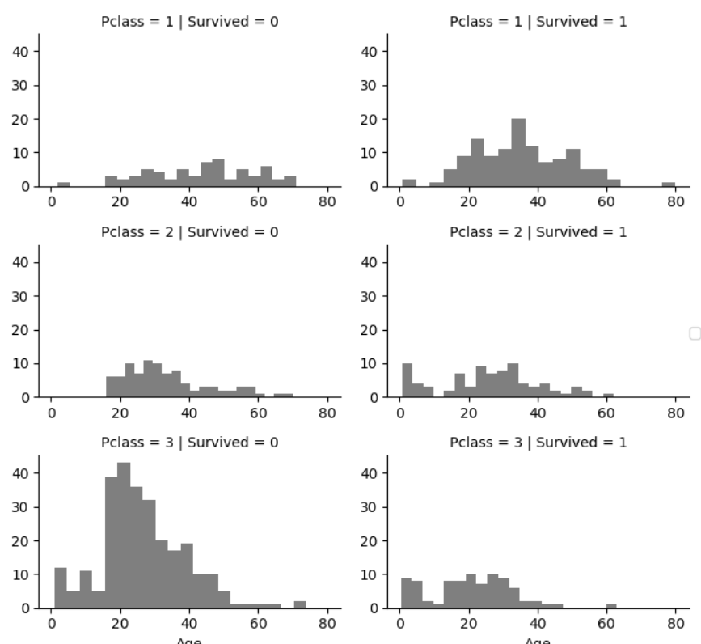
Observation based on PClass
Most of the passengers in lower class, i.e., Pclass = 3 didn’t survive. Pclass = 3 has most passengers.
Passengers of age 5 to 20 survived in Pclass 1 and Pclass 2
Most passengers of Pclass 1 survived.

Slide 11
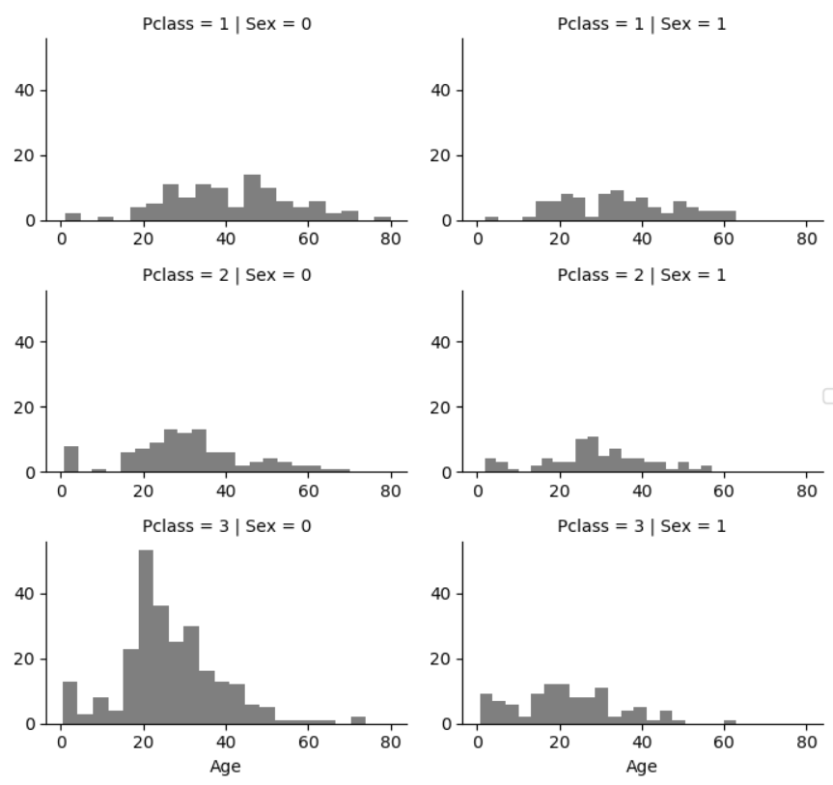
Filling missing values for age, comparing PClass and Gender
With PClass and gender features, we could see that the noise will be reduces considering the median of Gender and Pclass.

Slide 12
Creation & Conversion of Features

Slide 13
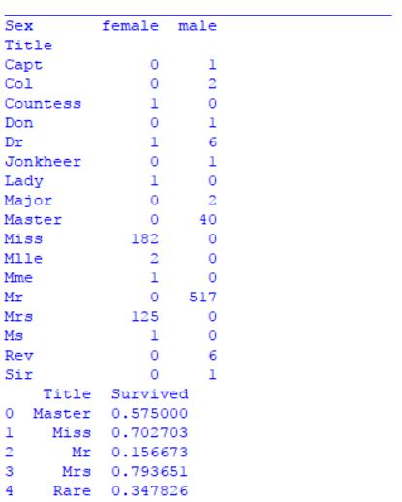
“Title” Feature
New feature called “Title” was created by extracting part of the “Name” feature.
Title has direct contribution to Age feature, but has indirect contribution towards survived feature.

Slide 14
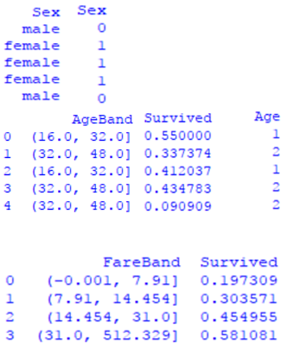
“Gender, Age and Fare” Features
Gender feature was converted to Ordinal values
AgeBand feature was created to convert Age feature to Ordinal values.
FareBand feature was created to convert Fare feature to Ordinal values.

Slide 15
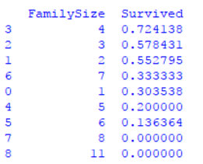
“FamilySize” Feature
FamilySize feature created from “Parent/Children” feature & “Siblings/Spouse” feature.
No contribution made by “FamilySize” feature, hence we dropped it.

Slide 16
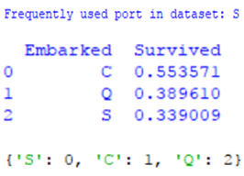
“Embarked” Feature
“Embarked” feature was filled with most frequently used location.
Categorical Embarked feature was converted to Ordinal values. S-Southamptom, C-Cherbourg, Q-Queenstown

Slide 17
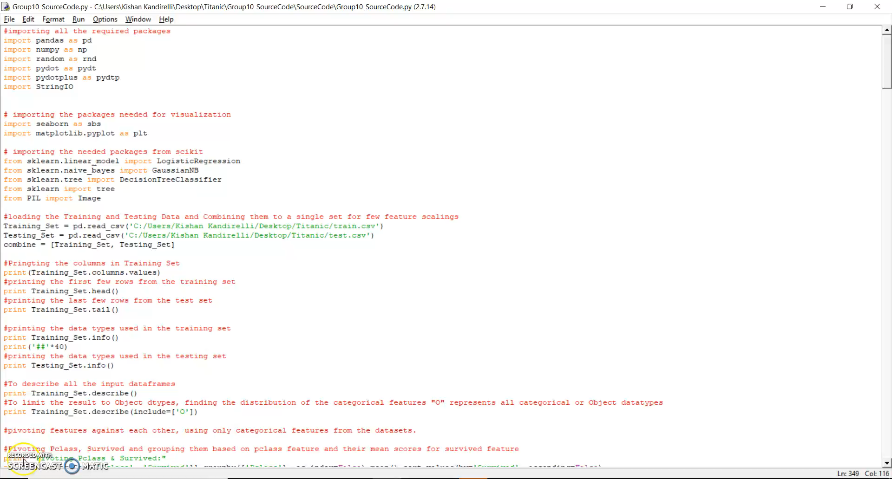

Slide 18
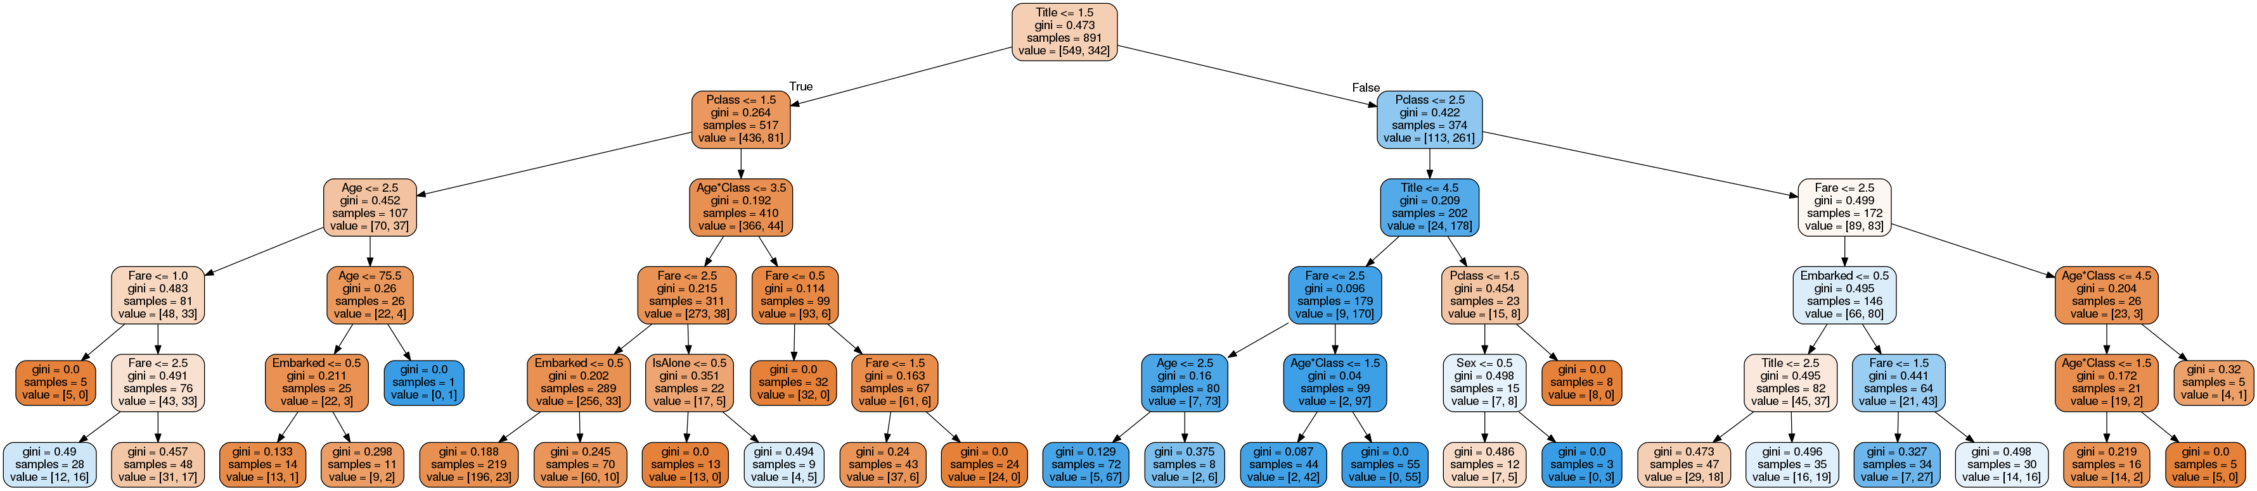
Decision Tree

Slide 19
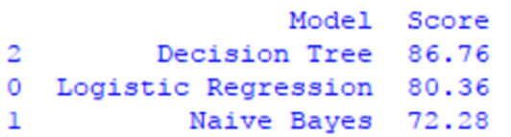
Accuracy

Slide 20
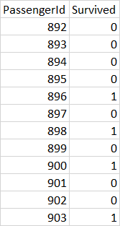
Sample Results of Test Data

Slide 21
Thank you !!

Slide 22
Questions ? & Suggestions..!

